Slide 1
QUIZ GAME
submitted by: M.Harshavardhini-AP21110010637 Anvitha Tulasi.N -AP21110010633
Y.Ananya D.Bhavitha
-AP21110010602
-AP21110010587
under the guidance of V.Veda Sri mam

Slide 2



INDEX:
Intro Algorithm Code Output
Conclusion

Slide 3
INTRO:
The project, quiz is a game in which players attempt to answer questions correctly about variety of topics in python(In this project the questionsare about python programming language). The player can choose the difficulty level of the questions and also the topic from which the questions should be asked. also the correct answers for the incorrectly answered questions will be displayed to the player. And at the end of the game the number of questions that the player answered correctly will be displayed.

Slide 4
Algorithm:
Step-1: Start Step-2:
Step 2.1: Enter
1->Data types and variables 2->Control flow statements 3->List
>Tuple
>Dictionary 6->Exit
Step 2.2: Read the choice from above If the choice is 6 then go to step- 8
Step-3: Enter the choice among given options for choosing the difficulty level of the questions. Step-4: Input the answer entered by the player
Step-5: If the answer is correct then print correct ,else print the correct answer Step-6: Print the total no of questions answered correctly
Step-7: Go to step 1
Step-8: Stop

Slide 5
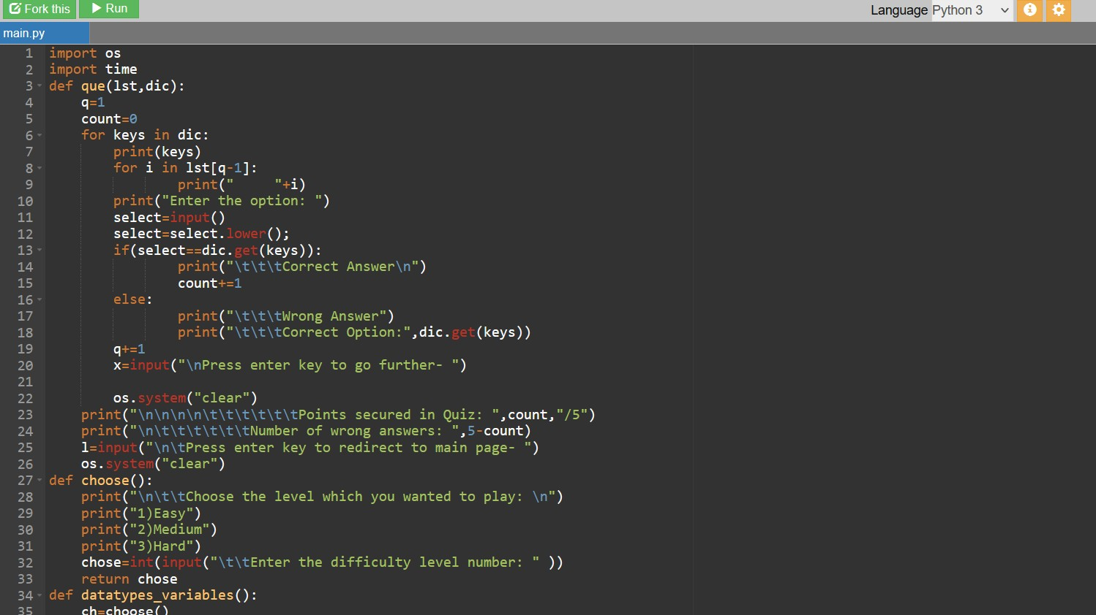
CODE:

Slide 6
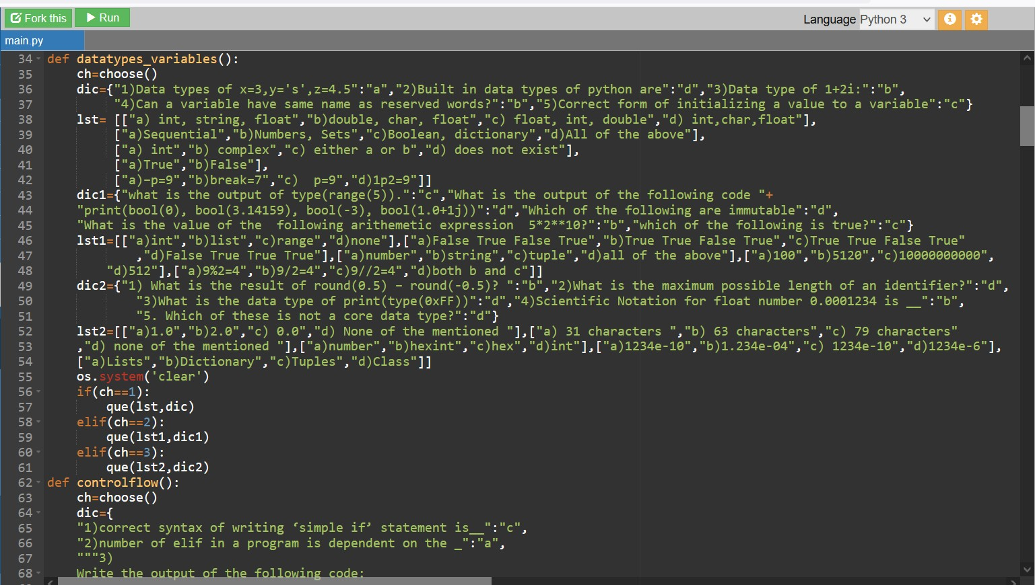

Slide 7
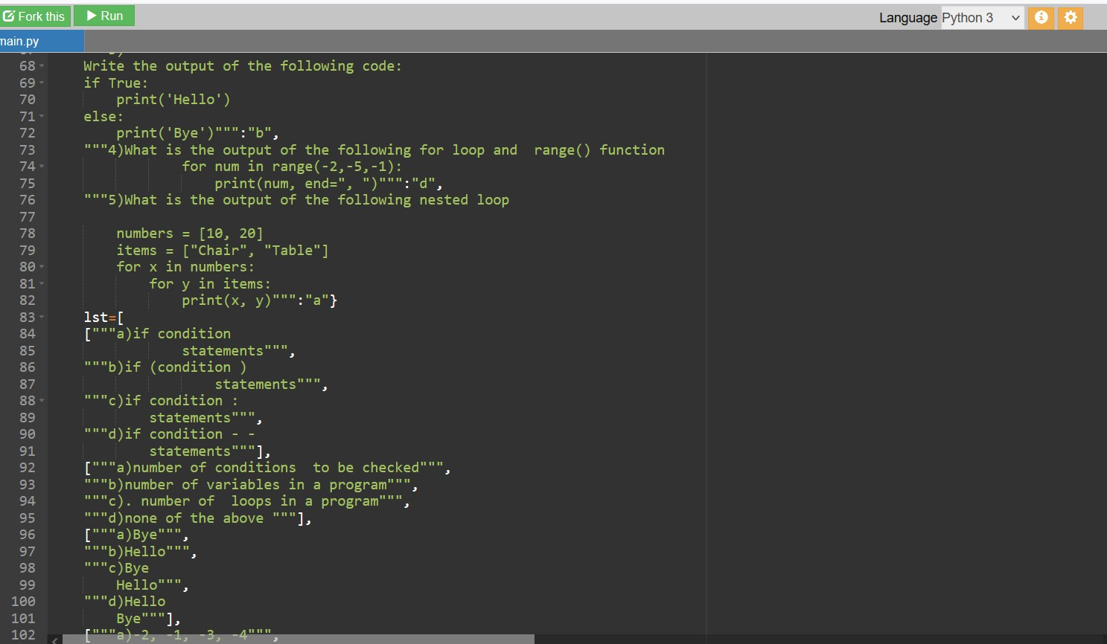

Slide 8
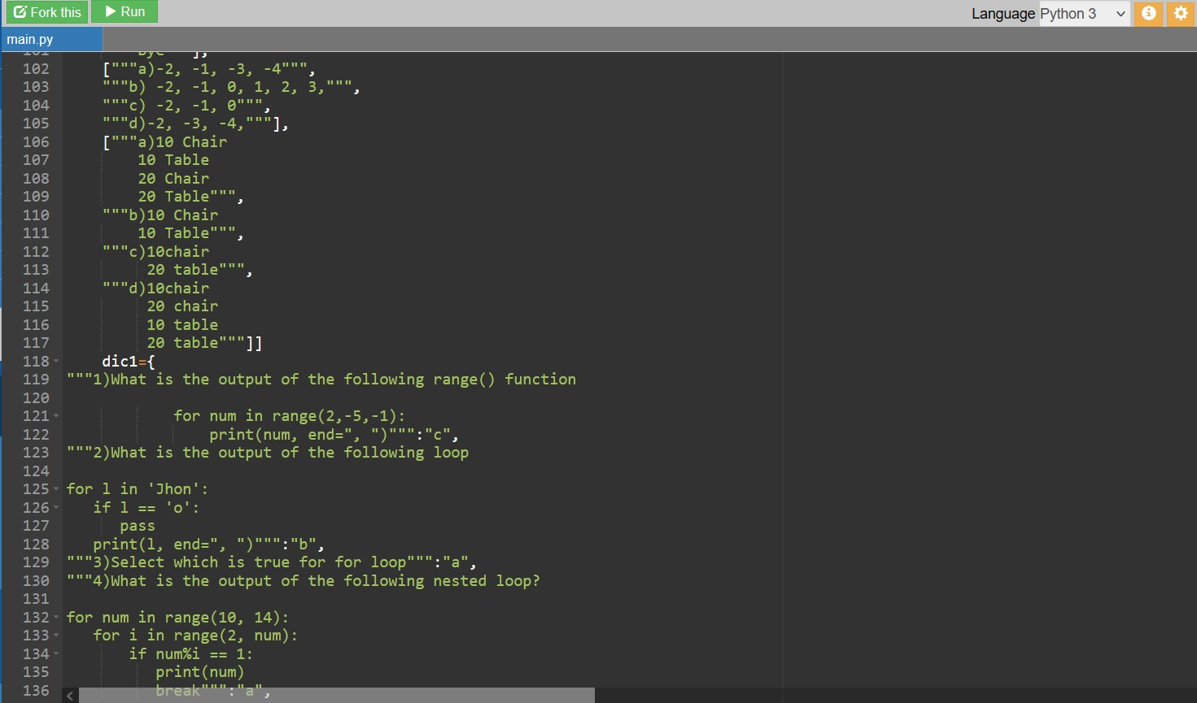

Slide 9
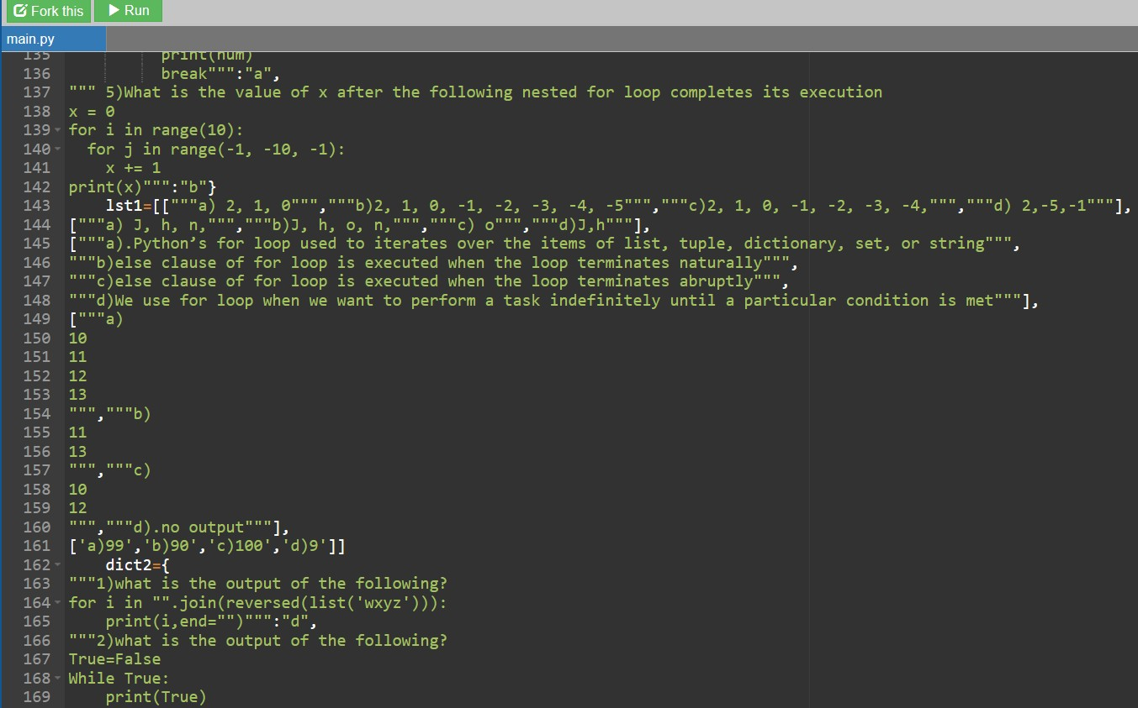

Slide 10
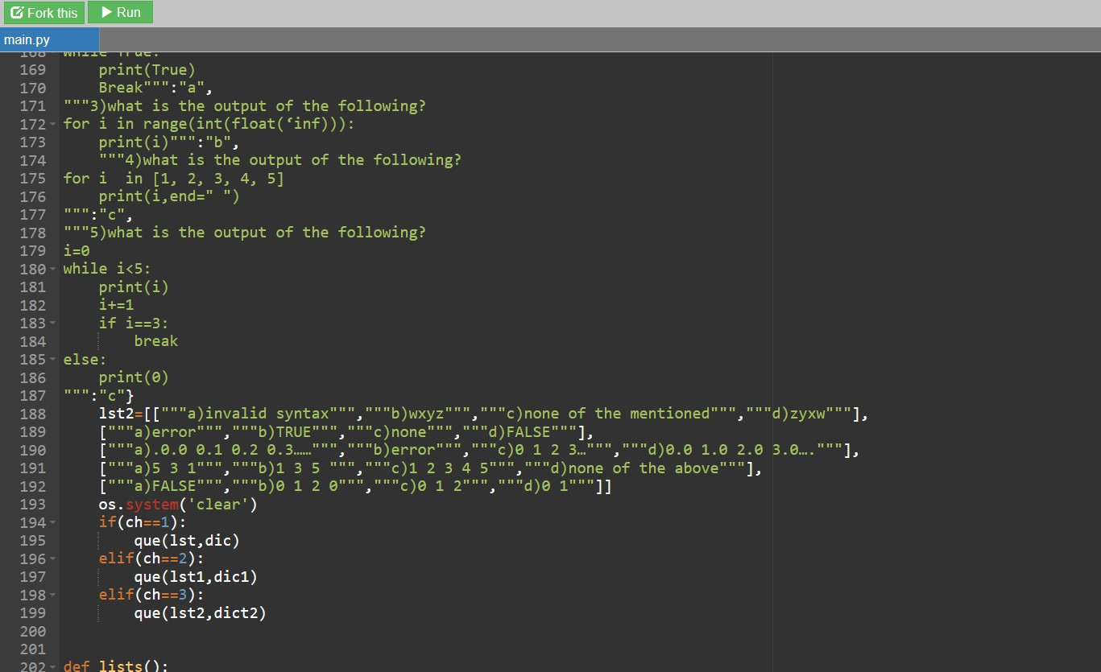

Slide 11
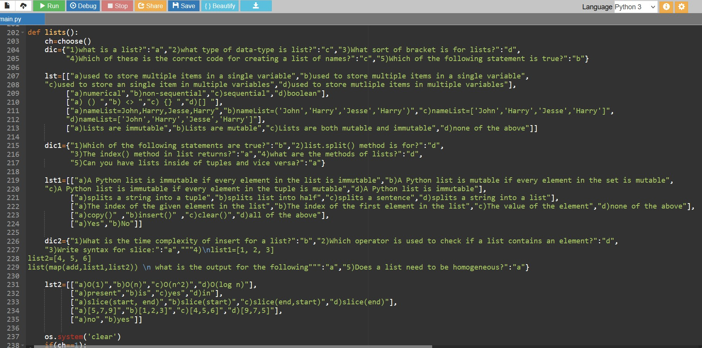

Slide 12
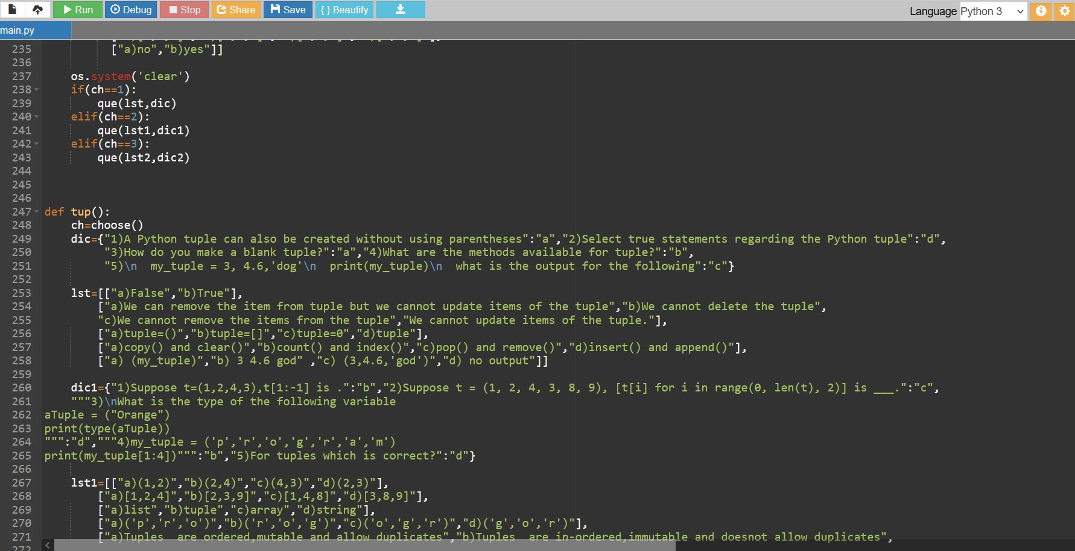

Slide 13
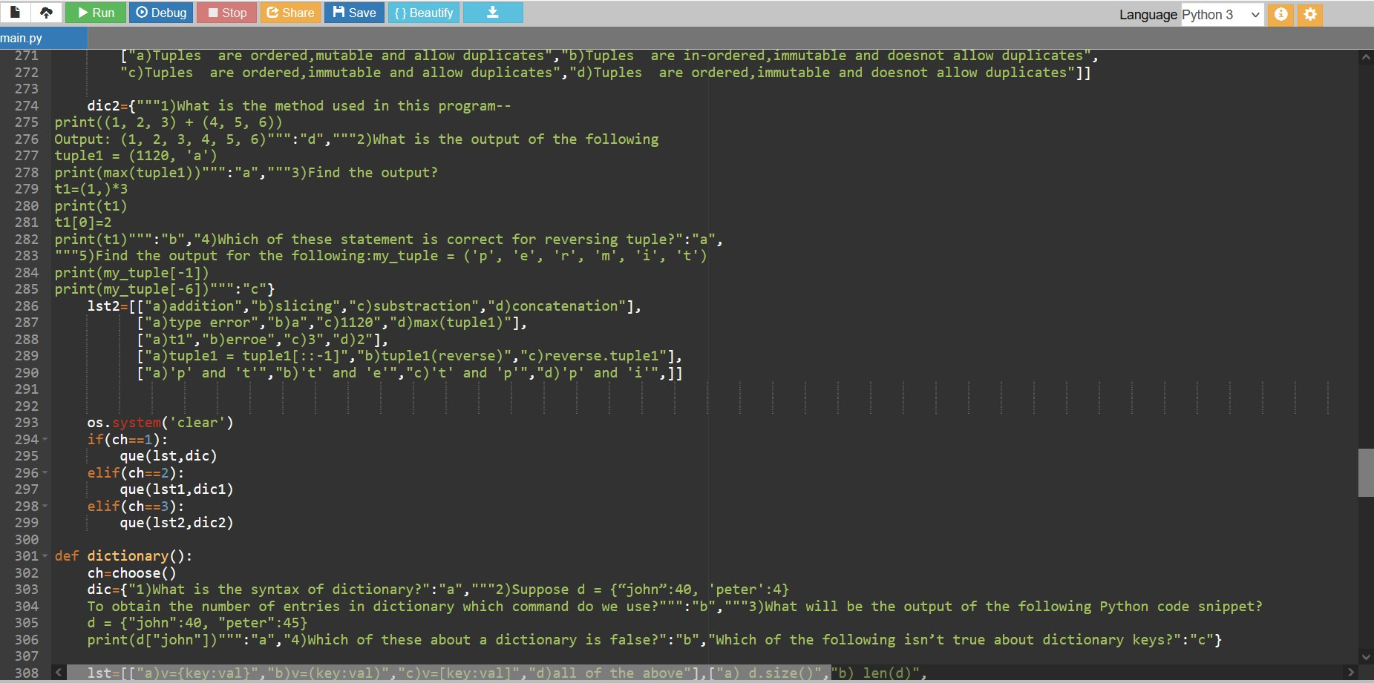

Slide 14
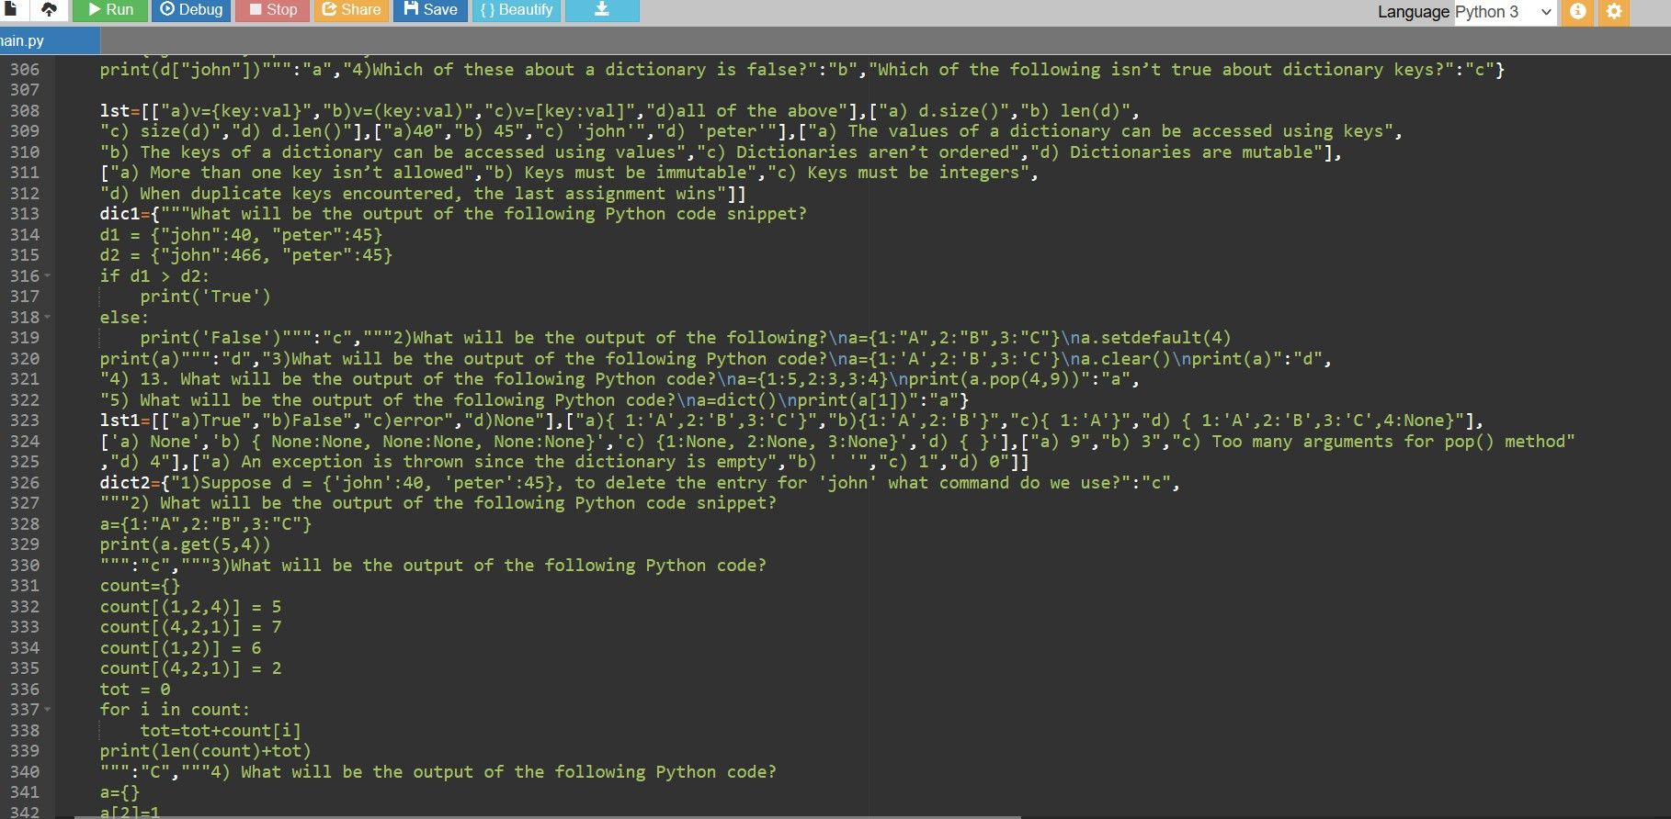

Slide 15
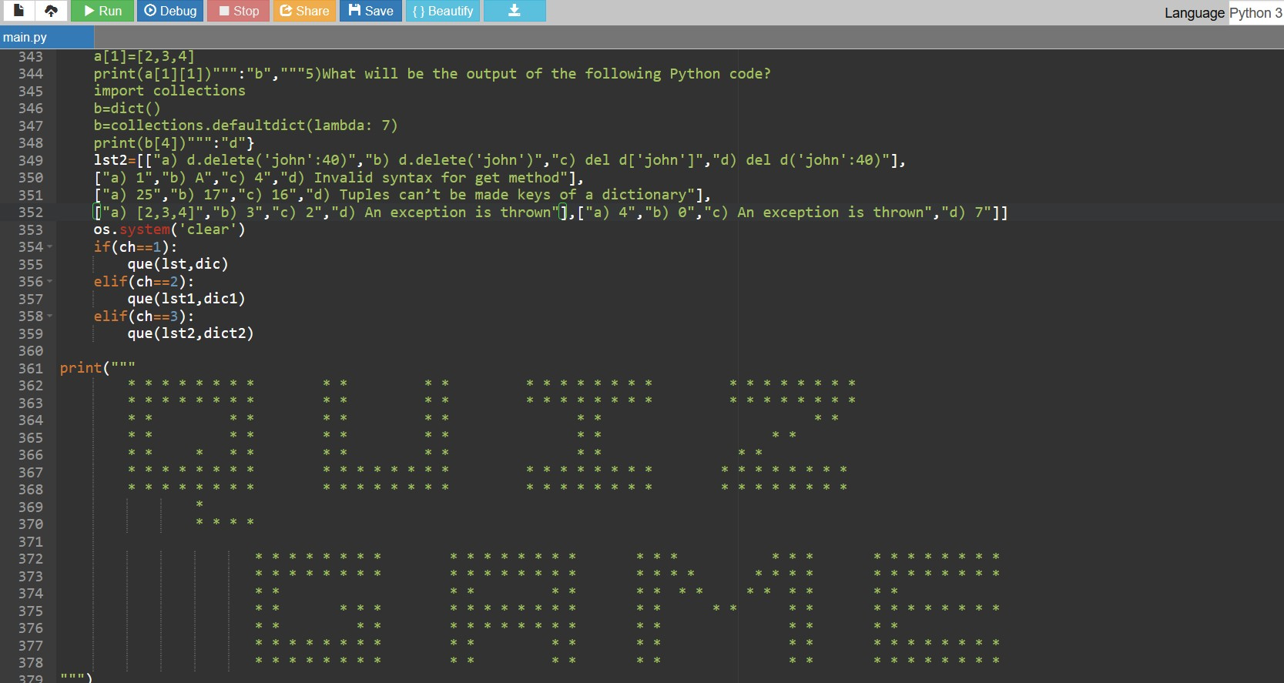

Slide 16
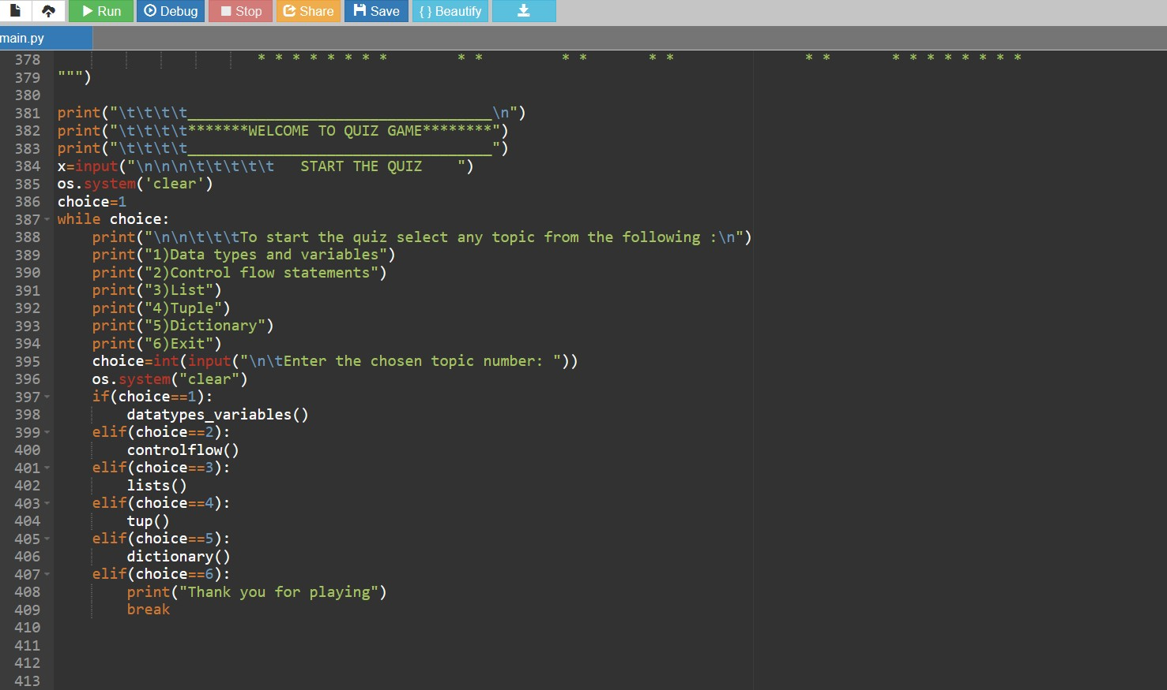

Slide 17
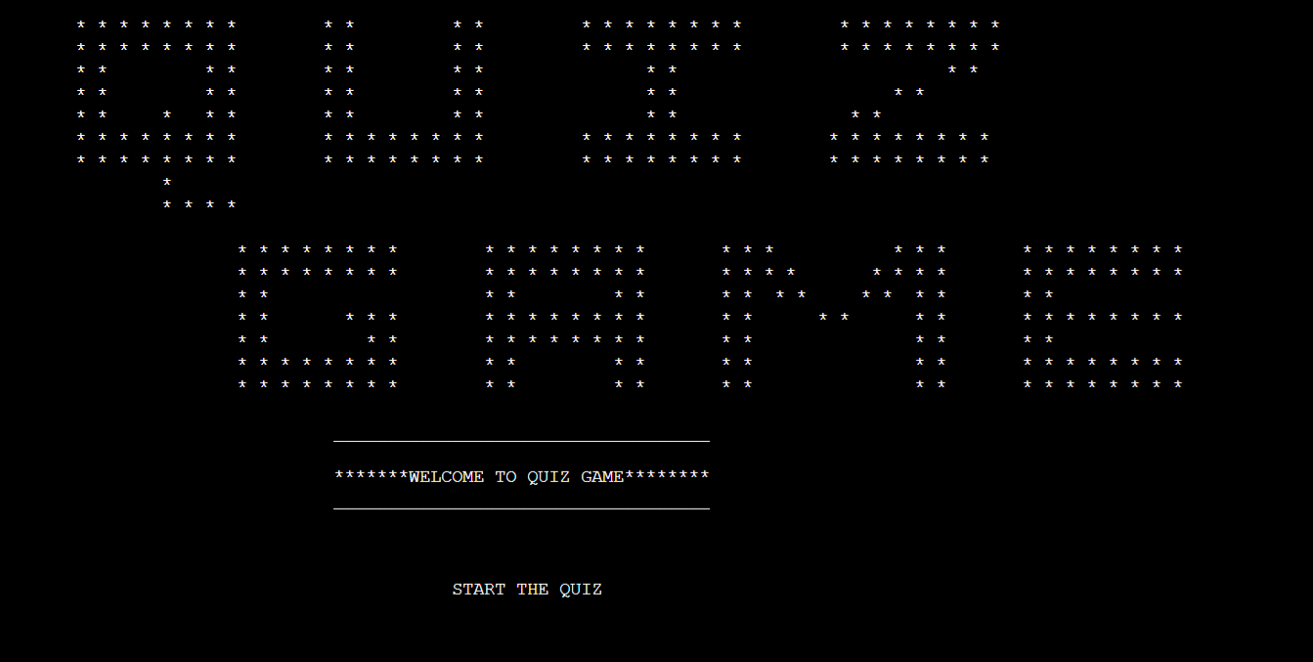
OUTPUT:

Slide 18
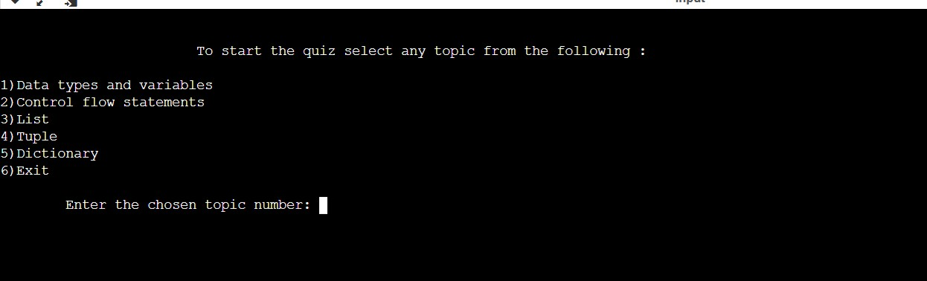

Slide 19
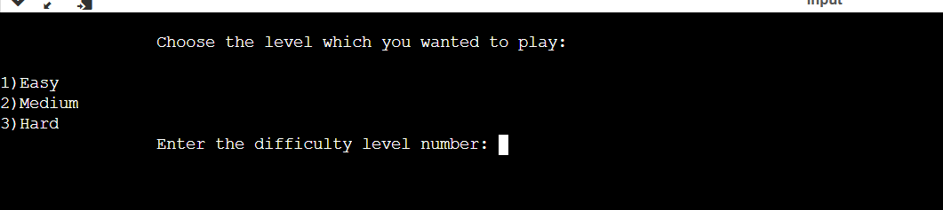

Slide 20
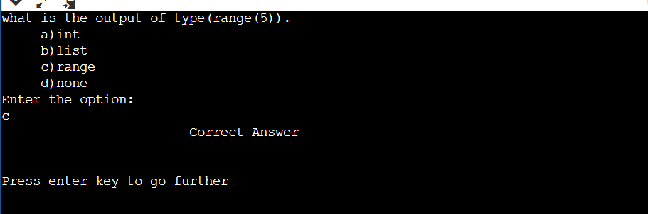

Slide 21
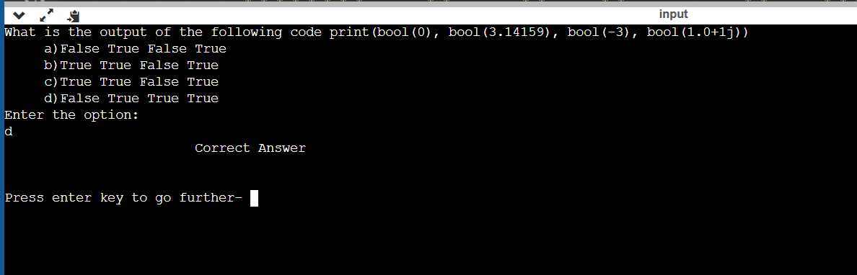

Slide 22
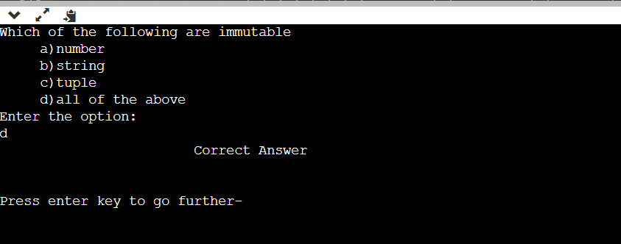

Slide 23
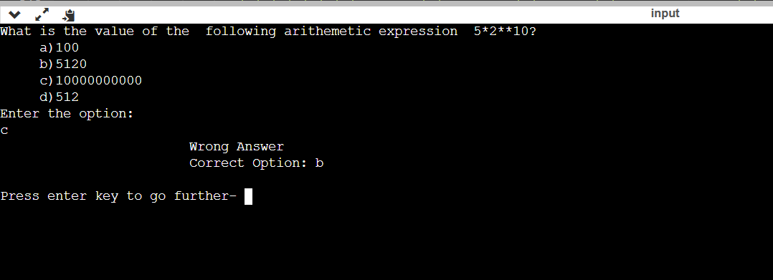

Slide 24
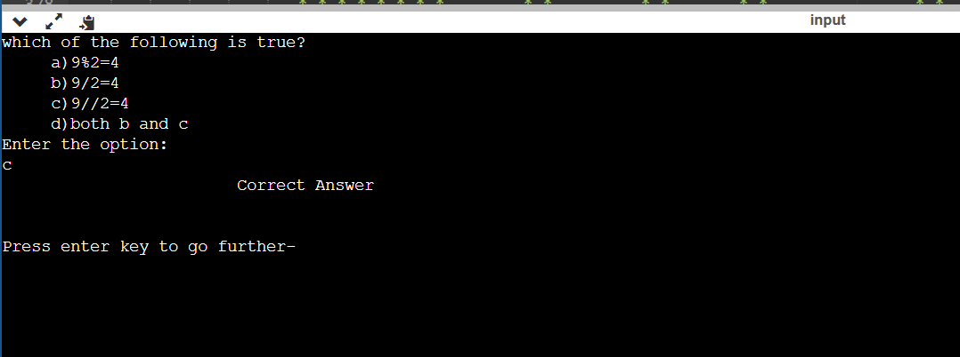

Slide 25
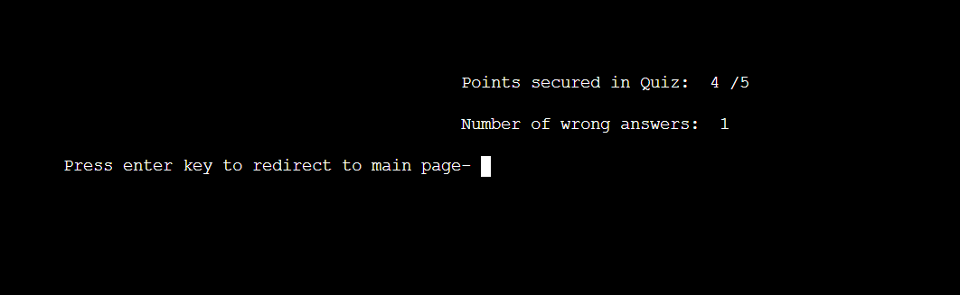

Slide 26
conclusion:
This quiz game provides the facility to play the quiz anywhere and anytime.The player don’t have to wait for the results and he can aslo get to know the correct answers immediately.It greately helps the player in improving his knowledge in the respective topics .

